Slide 1
Trouble Shooting the Stubborn /s/, /r/, /sh/ and /ch/
Laura Powell M.S., CCC-SLP, COM
laura@therapyu.org
573-777-8783

Slide 2
Goals for Webinar
Provide contraindications for targeting articulation only
Provide practical tools for immediate clinical use

Slide 3
Oral Mechanism Exam
Contraindications for Articulation Therapy Only
1) Ankyloglossia
Lingual (anterior and posterior)
2) Noxious Oral Habit
3) Dentition

Slide 4
Ankyloglossia
Somewhat thick, anterior tie
Thin, posterior tie

Slide 5
Ankyloglossia—Determining Course of Action
Step 1: Evaluate
Look for lingual range of motion (anterior and lateral)
For Example:
Elevation/Depression
Lateral movement
Protrusion/Retraction
**If mandible accompanies movement, may indicate limited ROM
**Physicians, dentists and orthodontists may miss the ankyloglossia!! You are the expert, now that you know ☺

Slide 6
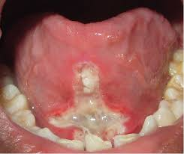
Ankyloglossia-Referring
Step 2: Refer, depending on setting
Check policy regarding medical/dental referral
→Caution with school-based referral
Research potential providers to perform frenectomy
→Most of the time oral surgeon or dentist
→Laser vs. scalpel
→Counsel patients/parents regarding what to expect
--some lingual pain and treat with pain reducers
--some wet scabs (white in appearance)

Slide 7
Ankyloglossia-Post Frenectomy
Step 3: Therapy to always follow-up post frenectomy
1-2 weeks post procedure
Target lingual ROM
Target lingual posture for at rest and during speech to keep tongue up and off of surgery site

Slide 8
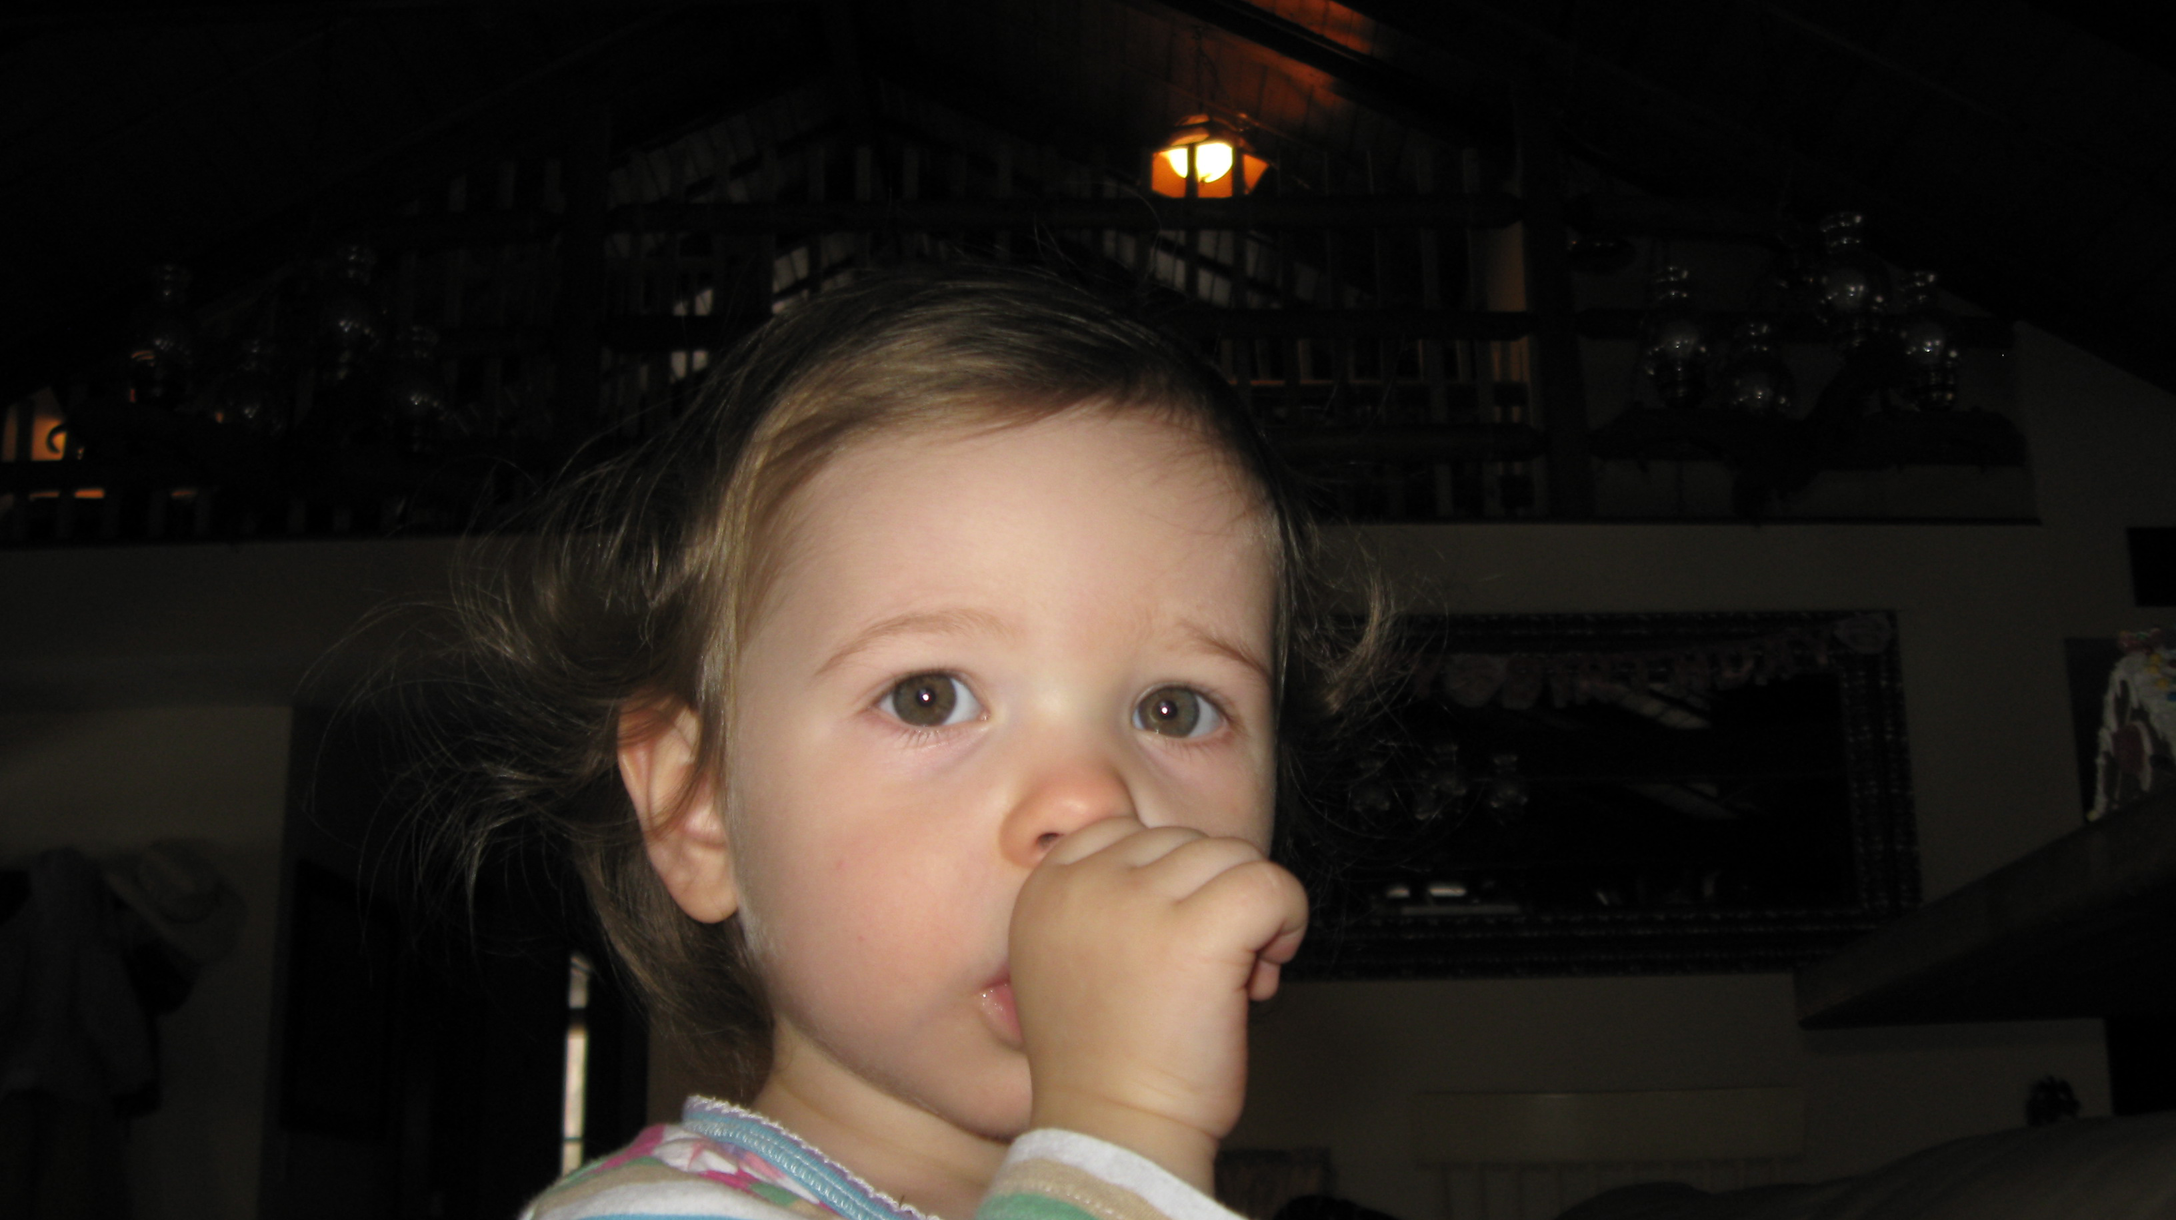
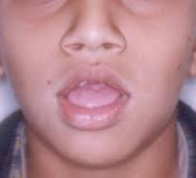
Noxious Oral Habit
Thumbsucking
Tongue Sucking
Sippy Cup Use
Digit Sucking

Slide 9
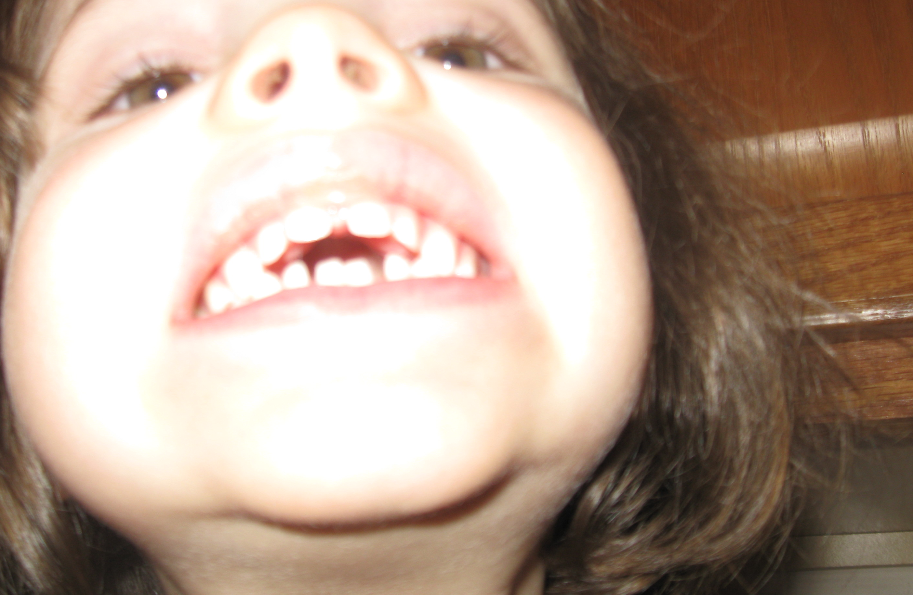
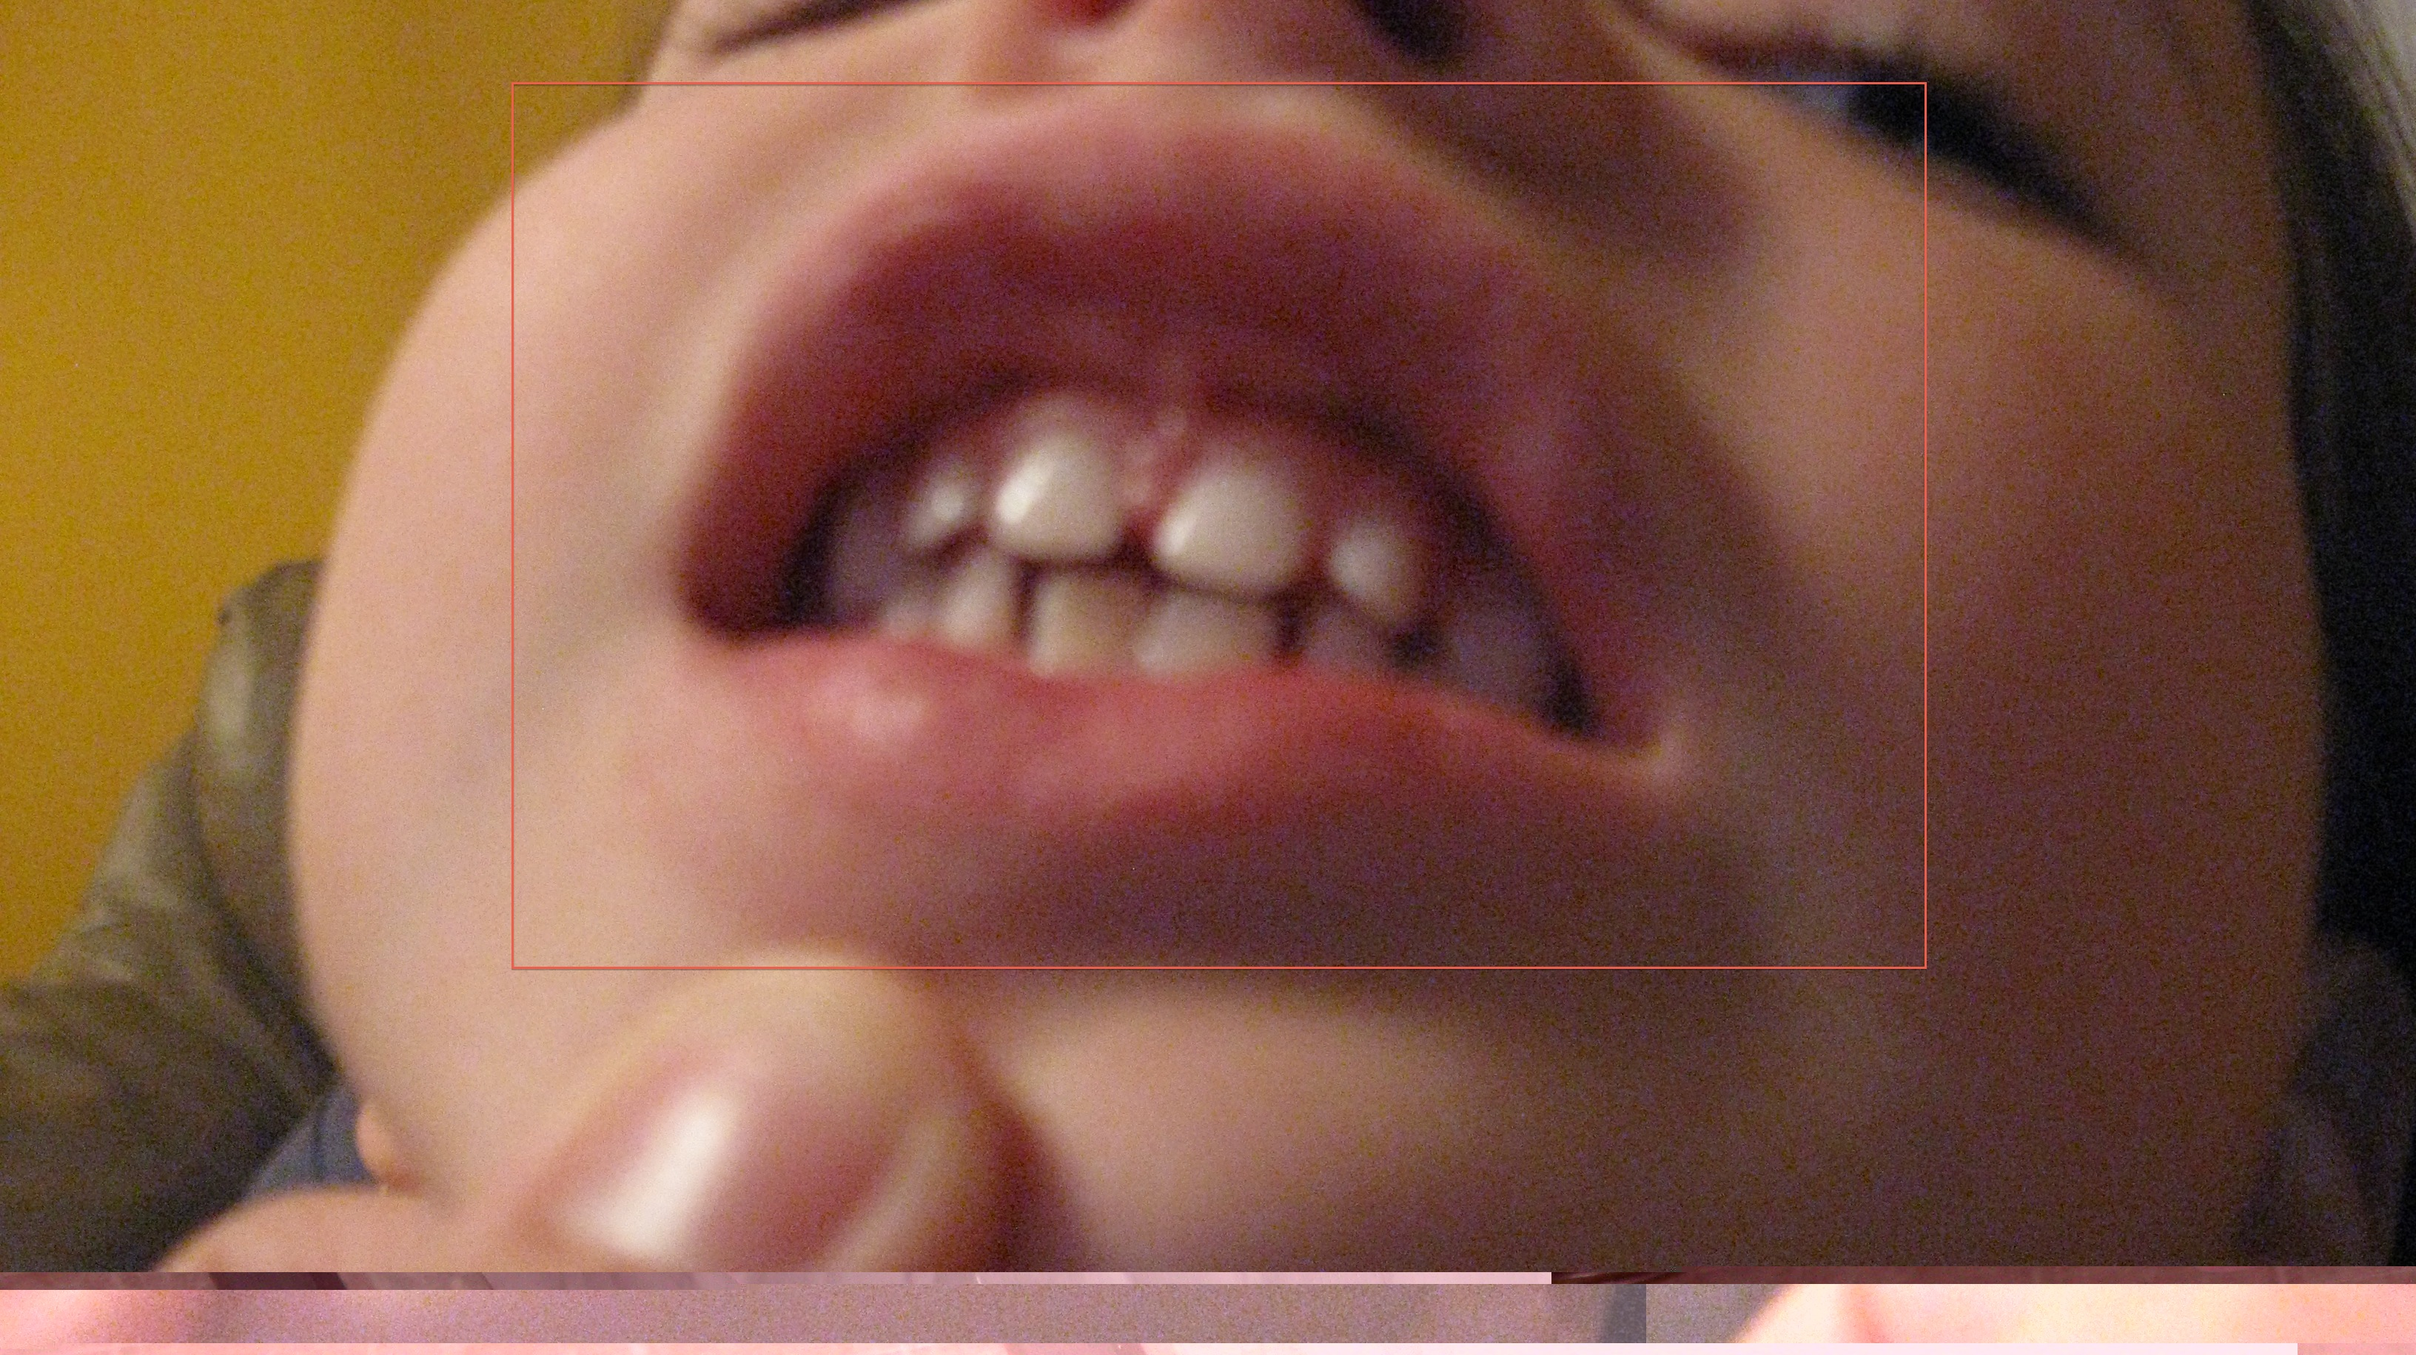
Addressing Noxious Oral Habit
Considerations:
Age
Motivation
Parent Involvement
Rationale:

Slide 10
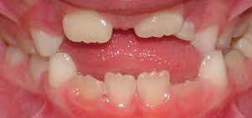
Dentition
Just a consideration…work can still be done
Education
Teach ideal resting tongue posture (tongue tip to alveolar ridge) to patient AND parents
Use a mirror!!

Slide 11
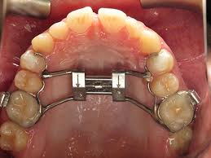
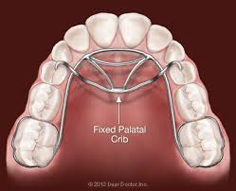
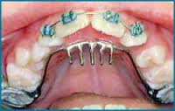
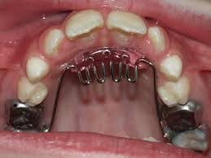
Orthodontic Considerations
Palatal Expander
Rakes and Cribs

Slide 12
Pre-Speech Work--Oral Proprioception
Definition: The ability to sense stimuli regarding position, motion, and equilibrium within and around the oral structure.
Laura’s Explanation to Families: Working so that the patient will be able to tell their tongue/lips what to do and where to go…

Slide 13
Laura’s Treatment Focus for Targeting Oral Proprioception
Range of Motion:
Goal=Without mandibular or labial movement
Elevation/Depression
Lateral
Protrusion/Retraction
Lateral tongue elevation (tongue bowl)
**These ROM targets isolate anterior, lateral and posterior tongue**
I DO NOT HAVE THE PATIENTS DO THESE EXERCISES WITHOUT A MIRROR—THE MIRROR INCREASES ORAL PROPRIOCEPTION

Slide 14
Hearing/Seeing Speech Differently
Don’t ignore /t/, /d/, /n/ and /l/
Even though /s/, /z/, /sh/ and /ch/ may be your primary target, targeting /t/, /d/, /n/ and /l/ may improve overall lingual function for all speech sounds
You may not be able to hear forward production…use your eyes too!

Slide 15
/r/
Tip Up
vs.
Back Up
Easy to see
Interrupts natural lingual posture for speech
Can still make with posterior tongue tie
Difficult to see and describe
More natural sounding
Difficult to produce with any type of ankyloglossia
Potential to sound “throaty”
Which to target???
If the patient starts using one technique naturally and it sounds adequate…go with that one
Laura prefers Back Up because the tongue is in a more neutral position and allows for flow of other sounds

Slide 16
Back up /r/
Age to treat…
→ No specific age--depends on stimulability and patient understanding
Patient Education for Lingual Posture:
Explain tongue position with mouth model
Use tongue bowl to explain lateral tongue elevation
Use “ee” to help patient obtain tongue placement

Slide 17
/r/ in Isolation
Techniques:
Bite and Push
→have patient bite with back teeth
→instruct to push against teeth with sides of tongue (may need to do some tactile stimulation with popsicle stick)
→if lips aren’t “heavy” teach to shape sound with lip posture (mirror to be used)
“ee”→/r/
→watch for jaw to not drop
→teeth to stay closed then to use lips to shape sound (mirror to be used)
**Jaw is very important to consider. Most “flat” /r/s are produced with open jaw
**If the patient has heavy lips a lip retractor can be used or their own fingers to keep lips out of the way

Slide 18
/r/ Syllable
Begin with tongue in /r/ position and add sounds that don’t require (much) lingual movement
→her, fur, burr, purr, murr
Then, add syllables that require more lingual movement
→sir, kerr, gerr, nerr, lerr
**I have the patient produce the syllables with teeth closed and to watch lips carefully in mirror
**I teach the vocalic /er/ first

Slide 19
/r/ Words
Build onto vocalic /er/
→water, sister, butter, etc.
I still have the patient keep their teeth closed until they are really used to production with new position. Then I have them add jaw opening when saying words.
Add /ar/ with jaw movement
→star, far, car, etc.
If patient is having difficulty, break the sound down into 2 parts:
1) /a/ → 2) /er/
Listen closely so that the vowel is not distorted.

Slide 20
/or/
/or/--the most difficult to attain due to the extent of lingual transition movement needed for production
Use /er/ and build:
→Teach the /o/ vowel first and make sure production is adequate…watch for jaw to be low and lips to be rounded
→Use previous technique of /o/→/er/
→ Build with words like: “for”, “more”, “bore”, “sore”, etc.

Slide 21
/s/
Types of Production
Tip Up
Tip Down
Either production is adequate and both could sound natural. If a patient leans toward one production type…go with it.

Slide 22
/s/
Age to treat…
→ No specific age--depends on stimulability and patient understanding
Patient Education for Lingual Posture
→Use mouth model for lingual posture with lateral margins elevated
→Describe airflow down the mid-tongue

Slide 23
/s/ in Isolation
Techniques
Bite and Push
→have patient bite with back teeth
→instruct to push against teeth with sides of tongue (may need to do some tactile stimulation with popsicle stick)
→as they push, encourage them to feel the mid-tongue “tunnel” and let the air flow
/t/→/s/
→have the patient practice /t/, making sure that tongue tip is on alveolar ridge
→have the patient say /t/, /t/, /t/…on the 3rd /t/ have them hold the /t/ to make a long /t/, which will turn into a /s/ sound
→sometimes if they know you are listening for an /s/, they mess it up…so the long /t/ is a trick
“ee”→/s/
→have the patient start with “ee” and transition to /s/
→the “ee” position allows for the mid tongue “tunnel”
/th/→/s/
→have the patient produce /th/ and keep it going
→have the patient keep the sound and slowly move the tongue back
→when the tongue gets behind teeth, have them close their teeth and an /s/ should result

Slide 24
That Darn Lateral /s/
Biggest Factor=Jaw Position
→If the patient juts their jaw forward, lateralizing /s/ will be easier
→Having the patient keep their teeth closed while using techniques described in previous slide will help eliminate laterality
→Try to make a lateral /s/ while teeth are closed…

Slide 25
Next Steps for /s/
After the patient successfully produces the /s/…move on to a traditional therapy model with syllables, words, phrases, sentences, oral reading, structured conversation and unstructured conversation
When having the patient produce /s/ at the different levels, be sure to continue to watch for jaw stability

Slide 26
/sh/
Age to treat…
→ No specific age--depends on stimulability and patient understanding
Patient Education for Lingual Posture
→Use mouth model for lingual posture with lateral margins elevated
→Describe airflow down the mid-tongue
→Use mirror to pay attention to lip position during production

Slide 27
/sh/ in Isolation
Techniques:
Bite and Push
→have patient bite with back teeth
→instruct to push against teeth with sides of tongue (may need to do some tactile stimulation with popsicle stick)
→as they push, encourage them to feel the mid-tongue “tunnel” and let the air flow
→have patient watch lip position in mirror
/s/→/sh/
→Instruct the patient regarding watching lip position in mirror during the transition from /s/ to /sh/
→Depending on age, can describe change in tongue tension…difficult to demonstrate
“ee”→/s/
→have the patient start with “ee” and transition to /sh/
→the “ee” position allows for the mid tongue “tunnel”
→have patient watch lip position in mirror

Slide 28
That Darn Lateral /sh/ Trouble Shooting
Biggest Factor=Jaw Position
→If the patient juts their jaw forward, lateralizing /sh/ will be easier
→Having the patient keep their teeth closed while using techniques described in previous slide will help eliminate laterality
Main Goal=keep mid tongue down
→try small piece of food item (e.g. sprinkle, Cheerio) for tactile feedback on mid tongue during nice easy production
→If small open bite, have patient put popsicle stick along length of tongue to restrict elevation

Slide 29
Next Steps for /sh/
After the patient successfully produces the /sh/…move on to a traditional therapy model with syllables, words, phrases, sentences, oral reading, structured conversation and unstructured conversation
When having the patient produce /sh/ at the different levels, be sure to continue to watch for jaw stability

Slide 30
/ch/
Age to treat…
→ No specific age--depends on stimulability and patient understanding
Patient Education for Lingual Posture
→Use mouth model for lingual posture with lateral margins elevated
→Describe airflow down the mid-tongue
→Explain that there will be a stop in airflow and a build up in pressure to produce /ch/
→Use mirror to pay attention to lip position during production

Slide 31
/ch/ in Isolation
Techniques:
/sh/→/ch/
→use base skills of /sh/ to build upon for /ch/
→have the patient practice with /s/ and to lift tongue tip to stop airflow for production of /t/
→have them generalize the stopping of airflow of /sh/ for /ch/
→remember to have them watch lip position in mirror
If production is lateral:
→have the patient keep their back teeth together during attempts to discourage jaw protrusion

Slide 32
Next Steps for /ch/
After the patient successfully produces the /ch/…move on to a traditional therapy model with syllables, words, phrases, sentences, oral reading, structured conversation and unstructured conversation
When having the patient produce /ch/ at the different levels, be sure to continue to watch for jaw stability

Slide 33
Key to Treatment Success
Parental Involvement—I explain to parents that they are the ones that live with the patient, so it is important that they know the treatment goals and techniques.
Ideal Situation:
→Having parents in session to hear language SLP uses
→Watching techniques for at home carry over
→Having parents come in for a short instructional session could help—not just worksheets for home practice

