Slide 1
Using Rubrics in Speech-Language Pathology
A comprehensive option for data collection, treatment planning, and writing goals.

Slide 2
About Me
My name is Shanell Latta and I am the owner and operator of Big Sky Therapy Associates in the small mountain town of Whitefish, MT. My experience is pretty broad; I’ve worked with infants to geriatrics. I started my career working with school-aged children, migrated over to middle and high school students, and now work primarily with birth to three. My area of expertise is in Autism Spectrum Disorders, including cognitive communication and functional communication therapy. A large part of our practice is also diagnostics.

Slide 3
Outcome Measures
Following today’s webinar, you should be able to:
Explain the benefits of using rubrics over traditional data-collection systems
Use rubrics as a convenient way to track data/progress on individual goals
Use rubrics as a tool to organize qualitative data
Use rubrics as a guide for assessment and writing goals

Slide 4
Traditional Data Collection
Binary system (+/-)
Does not account for level of cueing
Often does not reflect slow growth
Can be difficult for “grey areas” of data collection
SOAP note
Time-consuming
Treatment plan/progress isn’t always visible “at a glance.”
Narrative data collection
Time-consuming
Hard to make quantifiable

Slide 5
Why use a Rubric?
QUICK & CONVENIENT
Way to organize qualitative data
Easy for others to use
Provide a roadmap for short-term goals and objectives
Shows growth, even with students who might progress slowly
Good measurement tool for our “tricky” students
AAC
Early Intervention
Social Skills
Executive Function Therapy
Language Intervention

Slide 6
Data Collection with Rubrics
Response level rubrics
Range of responses
Level of cueing
Matrices
Dynamic system for tracking data
Rating systems
Student ratings
Educator/Therapist ratings
Notes:
SMART goals: Specific, Measureable, Attainable, Realistic, Timely

Slide 7
Response Level Rubrics
Date | 1 | 2 | 3 | 4 | 5
 | Direct instruction only; <25% independent use of strategies/skills | Skill/strategies demonstrated in structured activity with a direct model and visual/verbal cueing | Skill/strategies demonstrated in structured activity, with moderate visual/verbal cues | Skill/strategies demonstrated in structured with minimal visual OR verbal cues | Skill/strategies demonstrated in structured activity with >95% competency observed.
 | Notes:

Slide 8
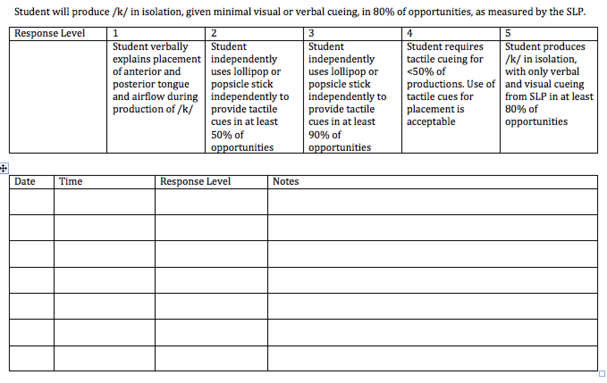
Articulation

Slide 9
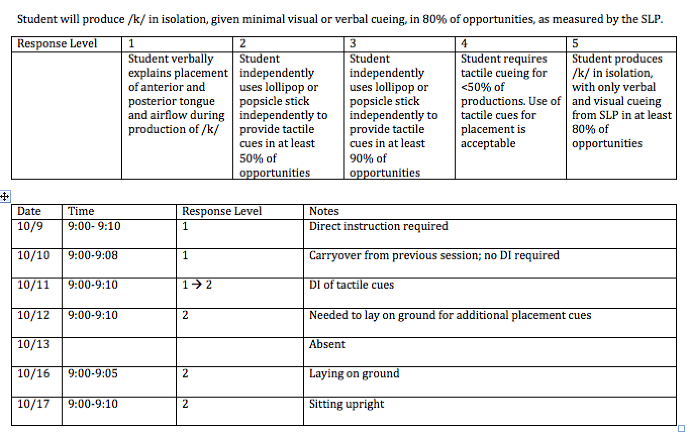
Articulation

Slide 10
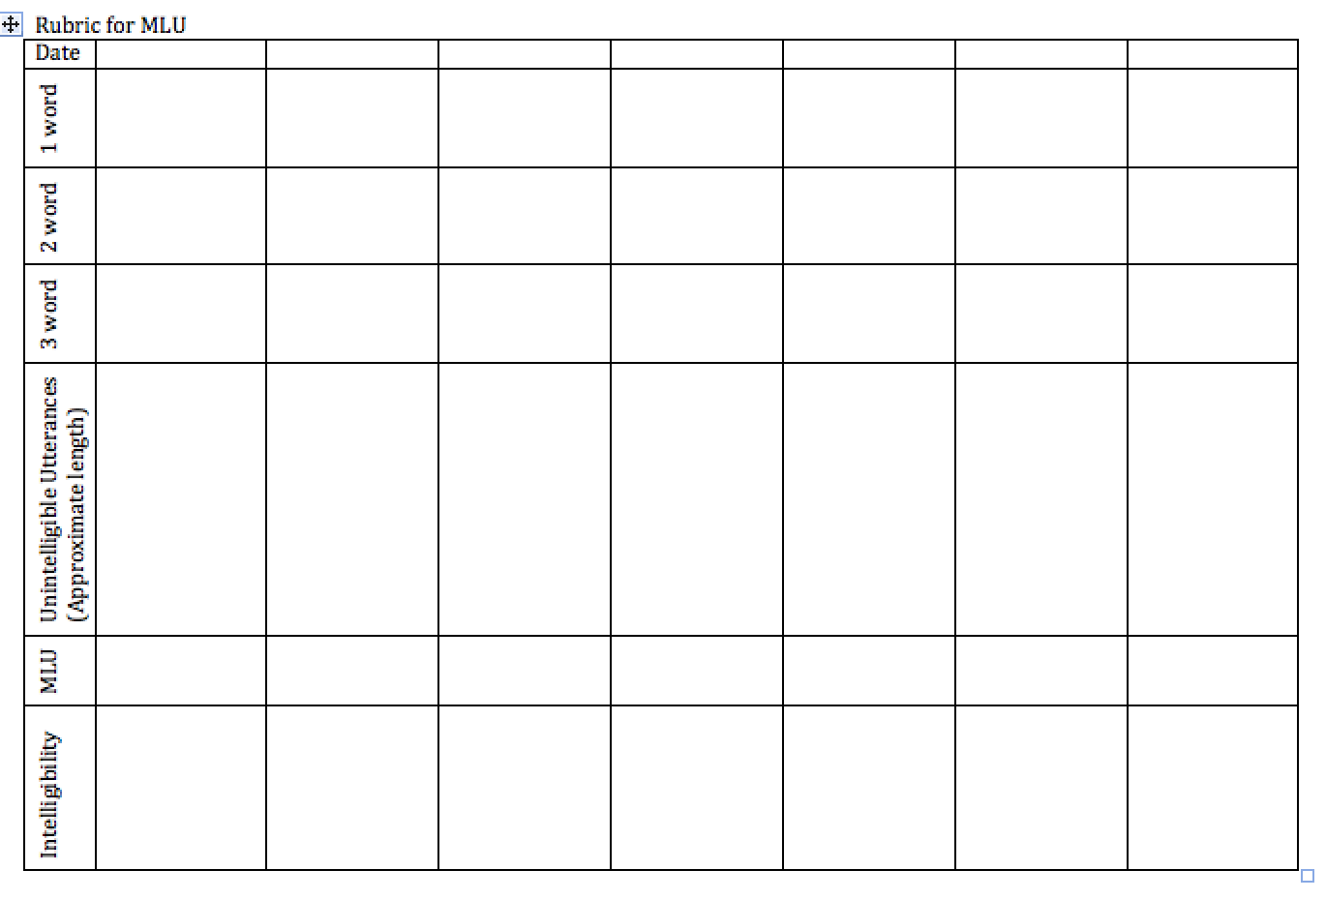
Early Intervention

Slide 11
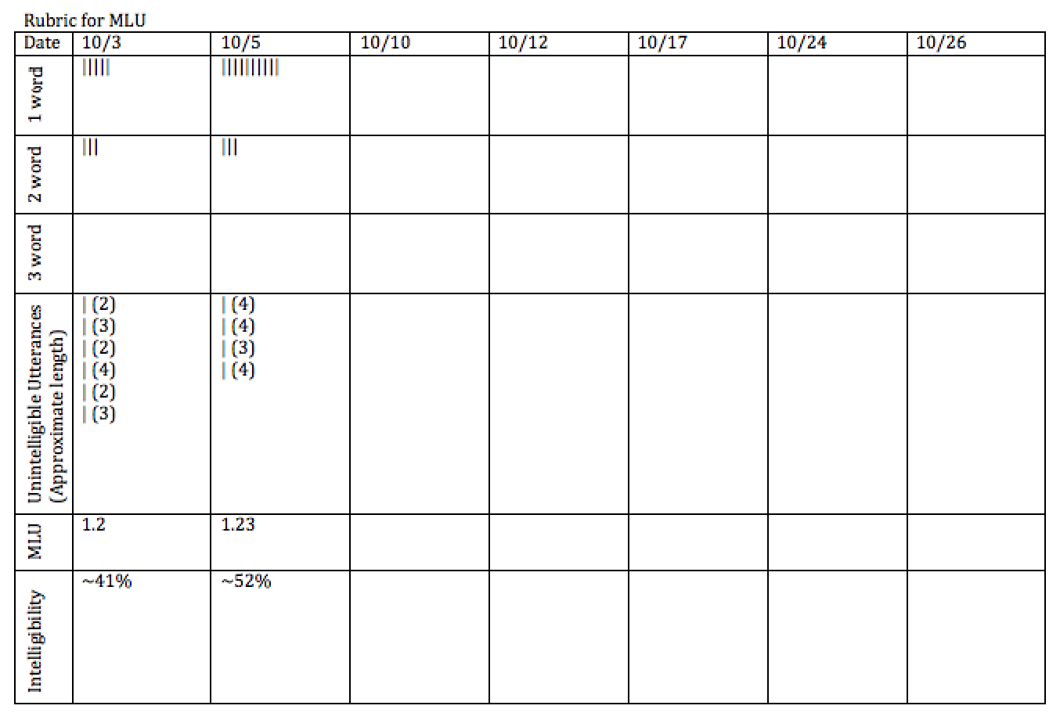
Early Intervention

Slide 12
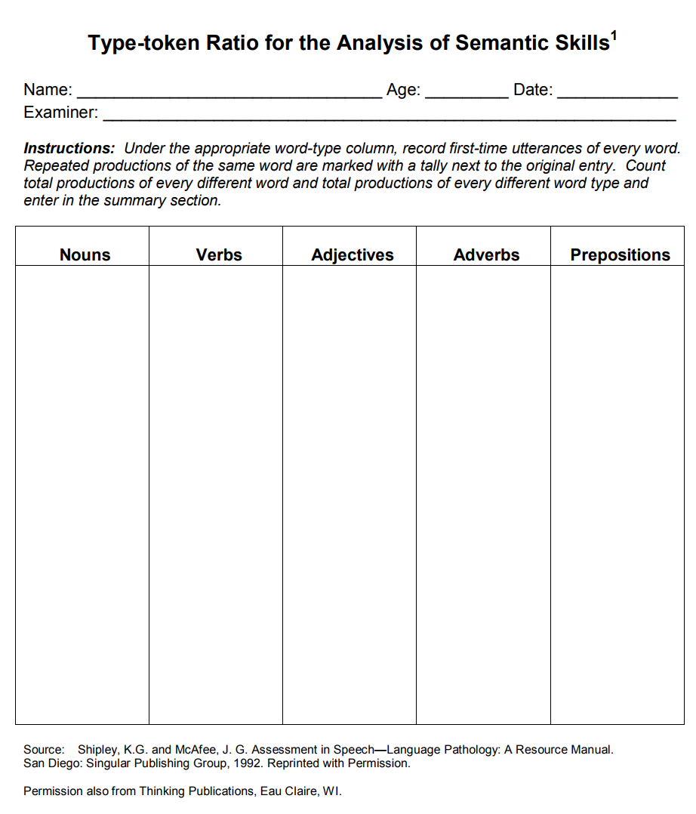
Rubric for EI
http://tennessee.gov/assets/entities/education/attachments/se_eligibility_speech_lang_imp_lang_res_pkt.pdf

Slide 13
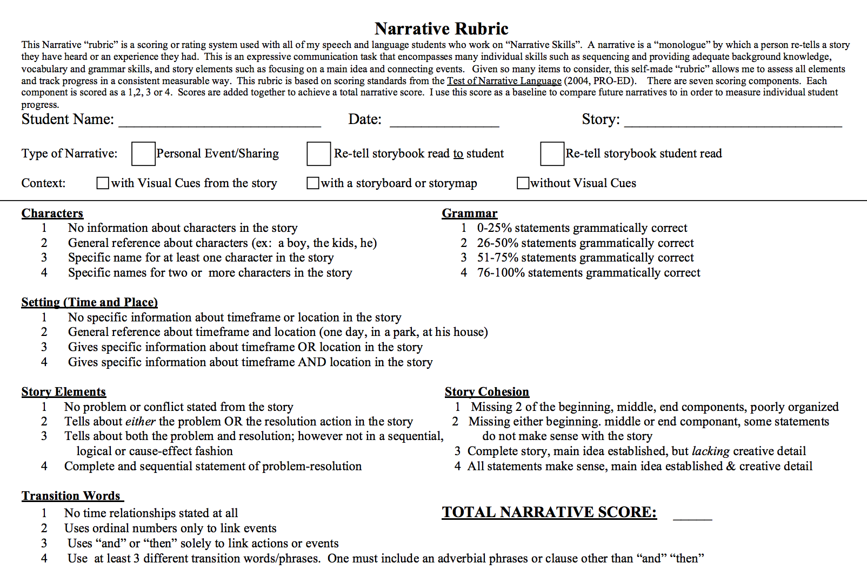
Narrative Skills
https://www.lcsc.org/cms/lib/MN01001004/Centricity/Domain/21/narrative-rubric.pdf

Slide 14
Matrices
Perfect for tracking multiple factors:
Client skill + setting
Client skill + level of cueing
Client skill + caregiver skill
 | Response Level →
← Response Level

Slide 15
Acquired Apraxia

Slide 16
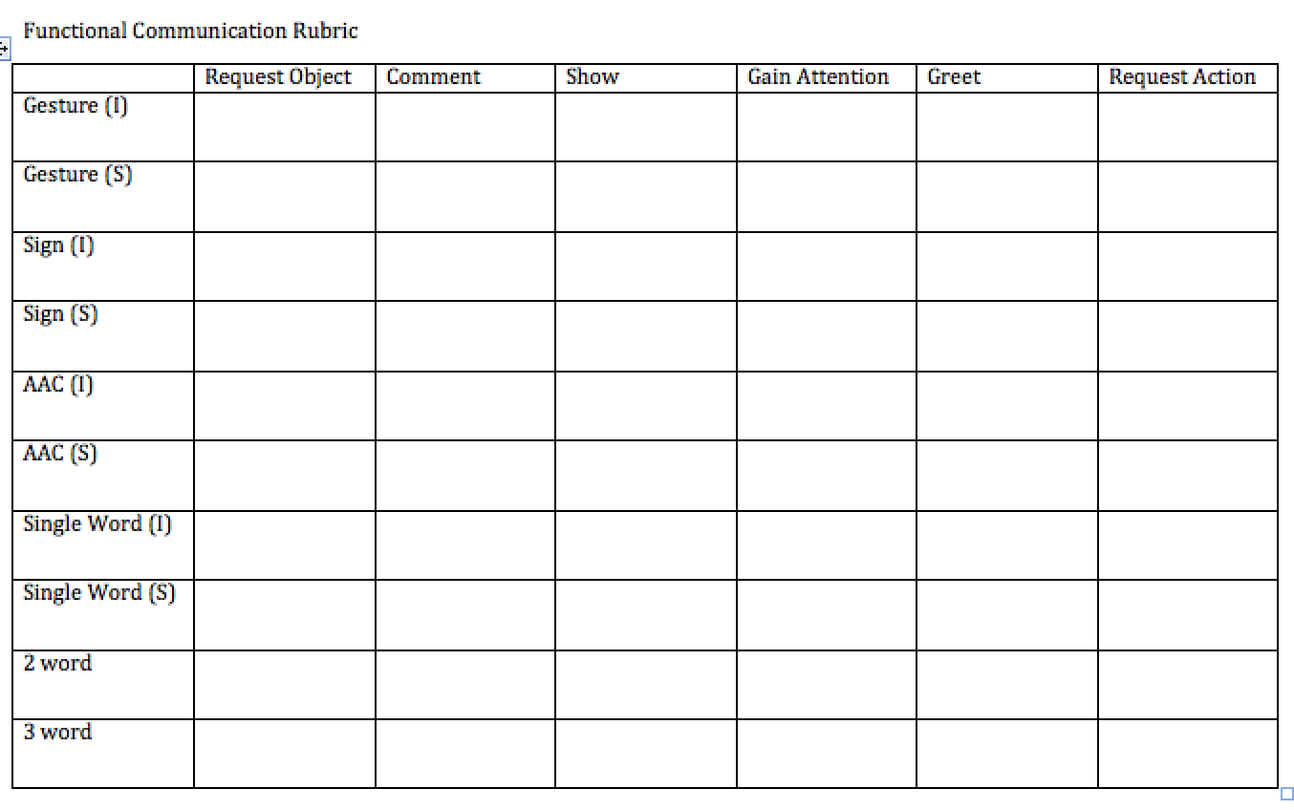
Functional Communication

Slide 17
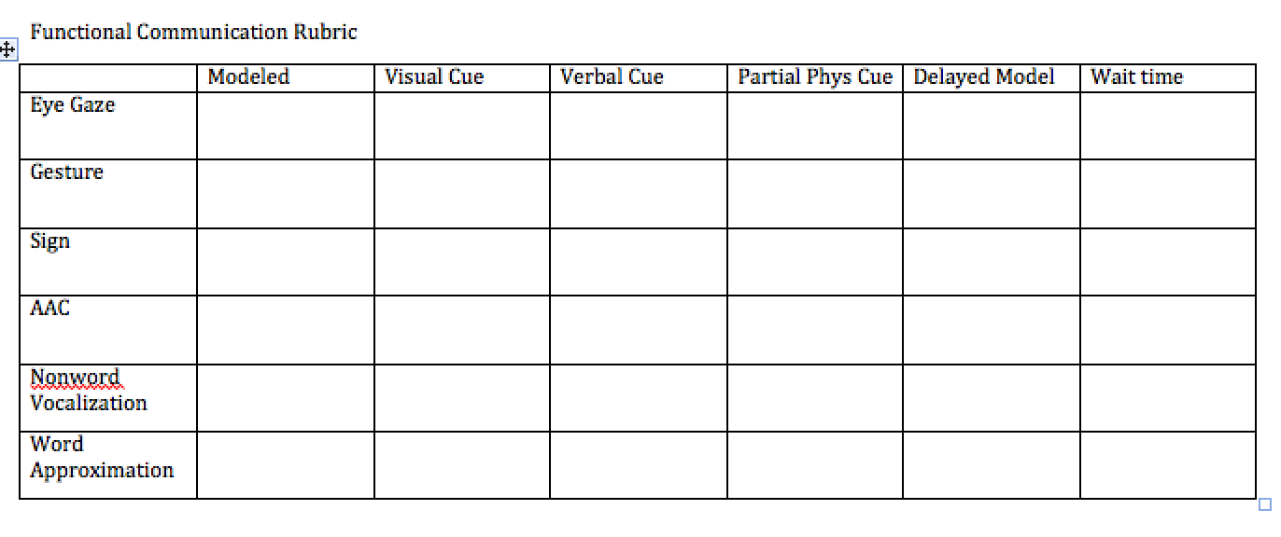
Functional Communication

Slide 18
Communication Matrix

Slide 19
Questions

Slide 20
Rating Systems
Helpful for assessments
Skills across settings
*Getting mean scores from different raters
Helpful to reconcile therapist/teacher/parent perception vs. student perception
Fluency
Social Thinking
Rate/Volume of Speech

Slide 21
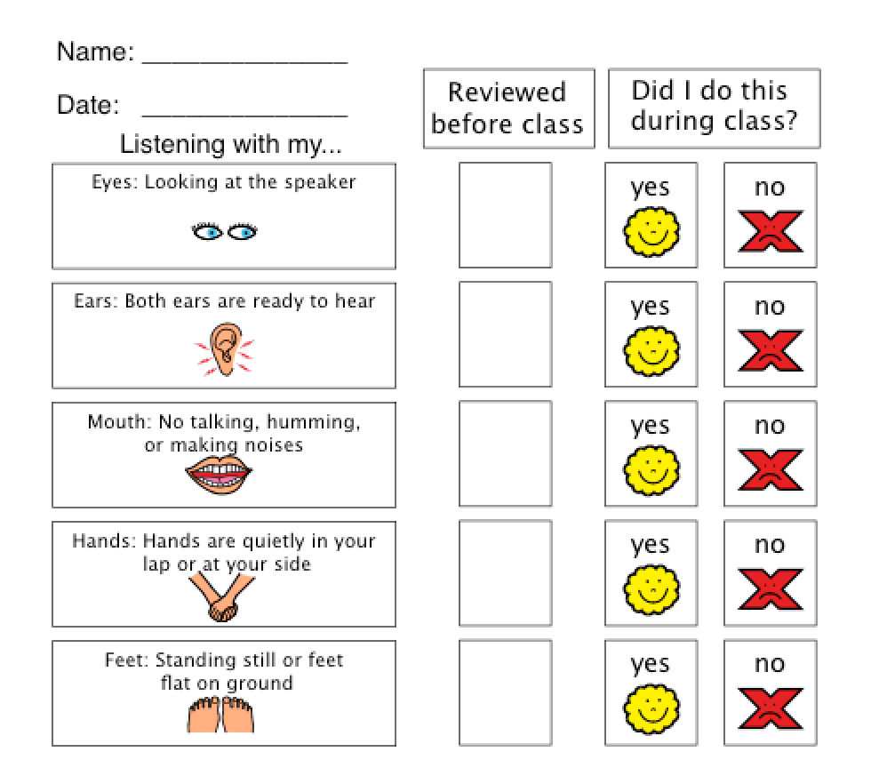
Social Thinking- Child

Slide 22
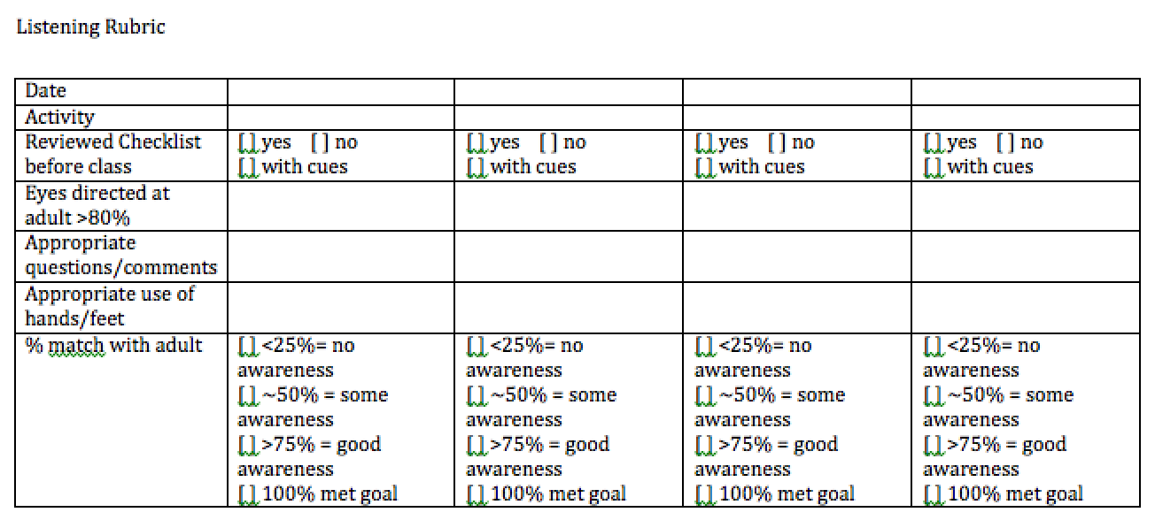
Social Thinking- SLP

Slide 23
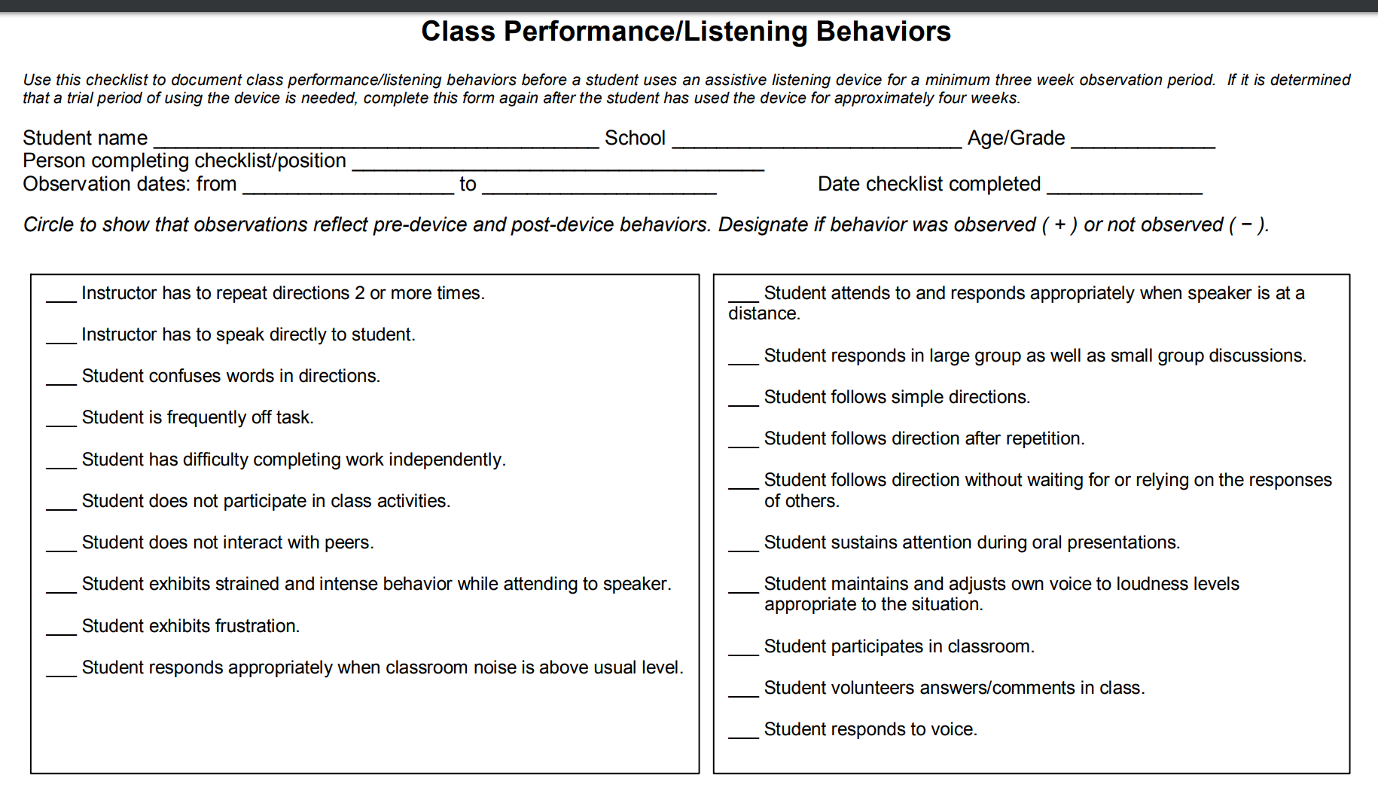
Social Thinking- Teachers

Slide 24
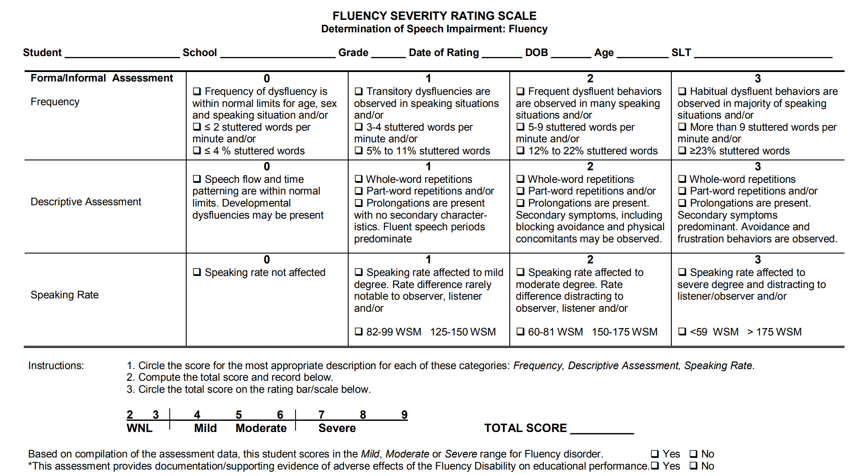
Fluency
http://tennessee.gov/assets/entities/education/attachments/se_eligibility_speech_lang_imp_fluency_res_pkt.pdf

Slide 25
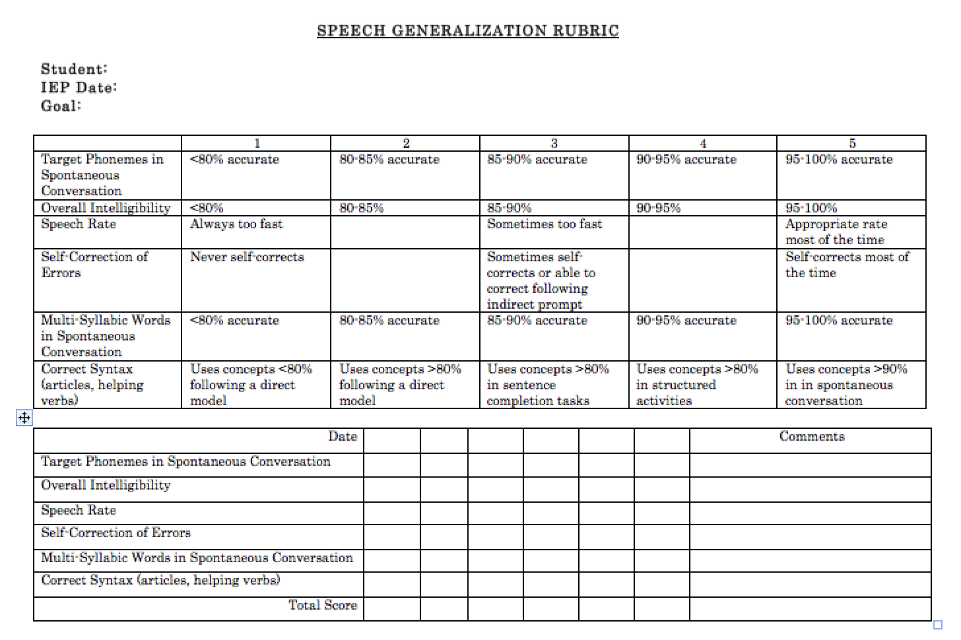
Speech Generalization

Slide 26
Questions

Slide 27
Using Rating Scales for Assessment & Progress Monitoring
Consider reliability vs. valuable information
Data can be valuable, but not reliable
Ways to improve reliability
Have the same (reliable) person take data
Have multiple people take data at the same time
Compare to your own data

Slide 28
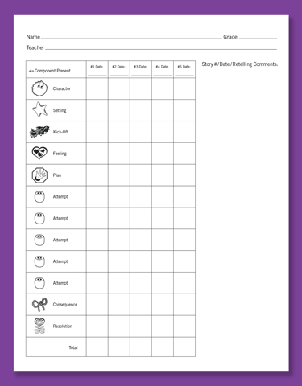
Rubrics and Existing Curriculums
Story Grammar Marker
https://mindwingconcepts.com/products/five-stories

Slide 29
http://www.4gaslps.com/BraidyProgMonInstructPlanner.jpg

Slide 30
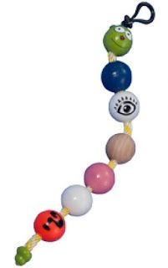
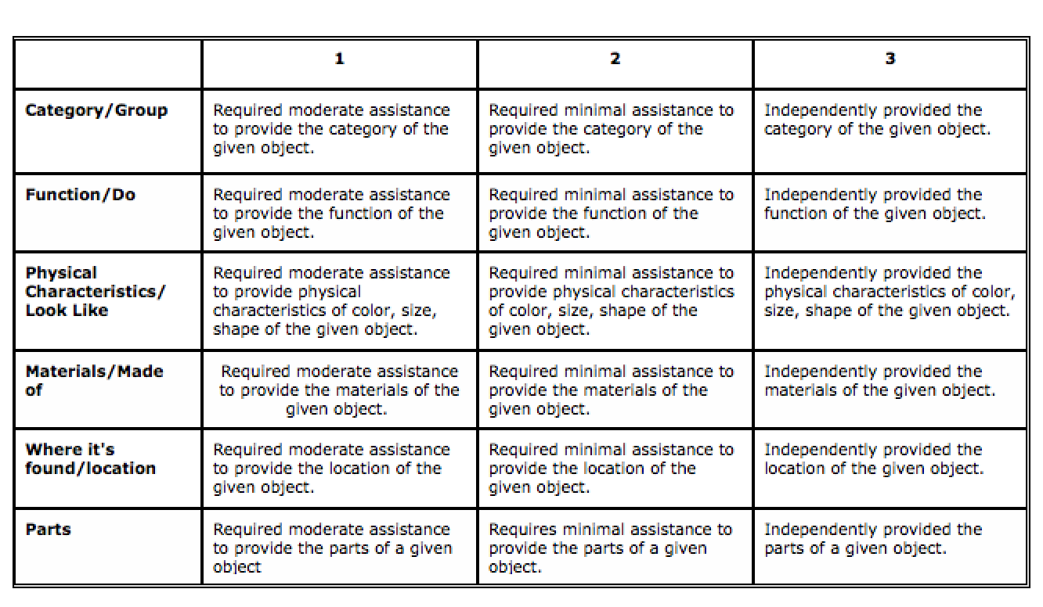
Rubrics and Existing Curriculums
Expanding Expressions Tool

Slide 31
Rubrics and Common Core
CCSS.ELA-LITERACY.L.6.4.A: Use context (e.g., the overall meaning of a sentence or paragraph; a word's position or function in a sentence) as a clue to the meaning of a word or phrase.
Date | 1 | 2 | 3 | 4 | 5
 | Direct instruction only; <25% no independent use of strategies/skills | Skill/strategies demonstrated in structured activity with a direct model and visual/verbal cueing | Skill/strategies demonstrated in structured activity, with moderate visual/verbal cues | Skill/strategies demonstrated in structured with minimal visual OR verbal cues | Skill/strategies demonstrated in structured activity with >95% competency observed.
 | Notes:

Slide 32
Resources
http://tennessee.gov/assets/entities/education/attachments/se_eligibility_speech_lang_imp_lang_res_pkt.pdf
http://tennessee.gov/assets/entities/education/attachments/se_eligibility_speech_lang_imp_gen_res_pkt.pdf
http://tennessee.gov/assets/entities/education/attachments/se_eligibility_speech_lang_imp_fluency_res_pkt.pdf
http://tennessee.gov/assets/entities/education/attachments/se_eligibility_speech_lang_imp_voice_res_pkt.pdf
https://www.tn.gov/assets/entities/education/attachments/se_eligibility_sp-lang_svr-rating-scale_ed4070.pdf

Slide 33
Resources
http://blog.slptoolkit.com/criterion-reference-tests-vs-rubrics-vs-whatever-i-can-grab/
http://www.sped.sbcsc.k12.in.us/iiep/iepprocess/rubrics.html
http://www.mnsu.edu/comdis/isad10/papers/therapy10/burns10/burns10.html
http://www.rcampus.com/indexrubric.cfm

